Slide 1
DC# Manager
Created by Dylan Barnes and Jacob Visser
Part of DC# (Data Control Sharp) Software Suite

Slide 2
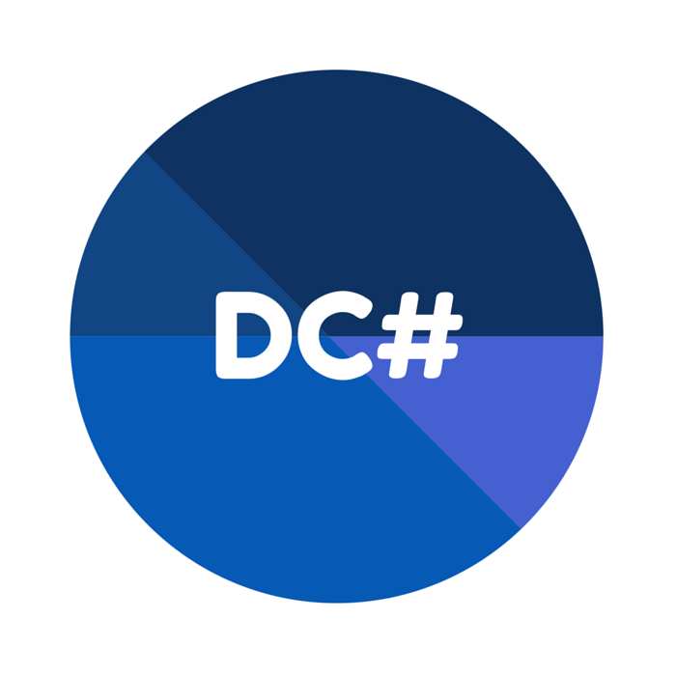
A Broad Overview of DC# Manager
Designed to be an open source database management system.
Easy to use through a GUI, Command-Line, or C# Library.
Allows users to create and export database tables from data files such as CSV, XML, and JSON through the power of DC# Converter.
Full user management support.
Connects to various types of databases, including cloud-based databases.

Slide 3
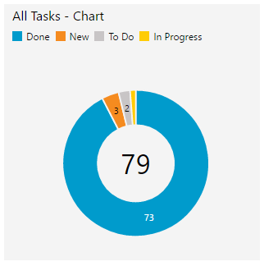
Agile Methodology
The Agile methodology was used throughout the development of DC# Manager.
Agile involves iteratively implementing features and creating documentation after the fact.
Used Team Foundation Server to manage sprints.

Slide 4
Features
Core Features
Additional Features
Store data by dynamically creating data tables from data files.
With proper permissions, edit data in the database.
Perform queries for content across the database using an intuitive search.
Portability through various interfaces.
Restricted access.
Connect to various databases, including cloud-based.
Create users through the GUI.
Export data tables to a data file.
Note: Supported data file types include XML, CSV, and JSON. Parsing is performed by DC# Converter.

Slide 5
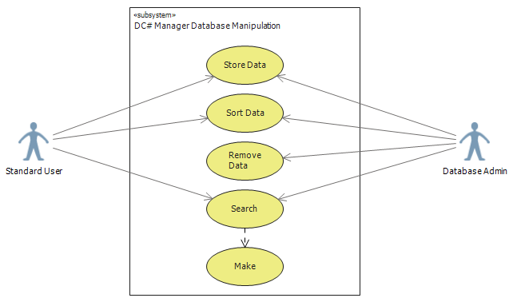
UML Use Case Diagrams
Diagram 1 – Database Manipulation

Slide 6
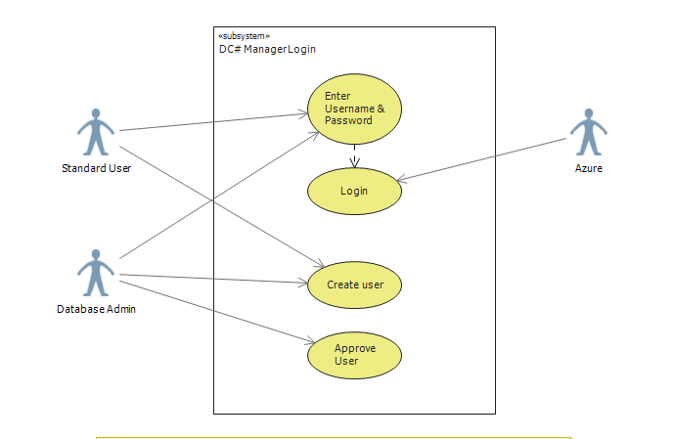
UML Use Case Diagrams
Diagram 2 – Manager Login

Slide 7
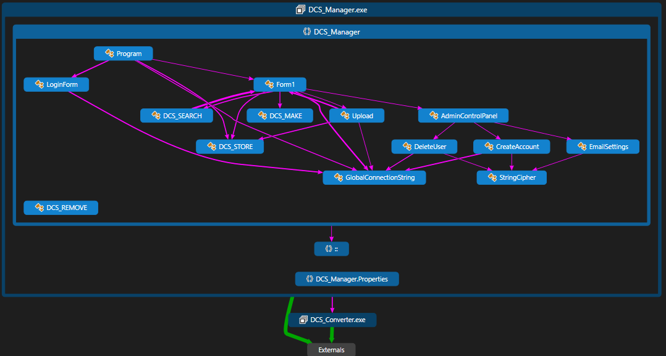
Code Diagrams
Broad Class Overview

Slide 8
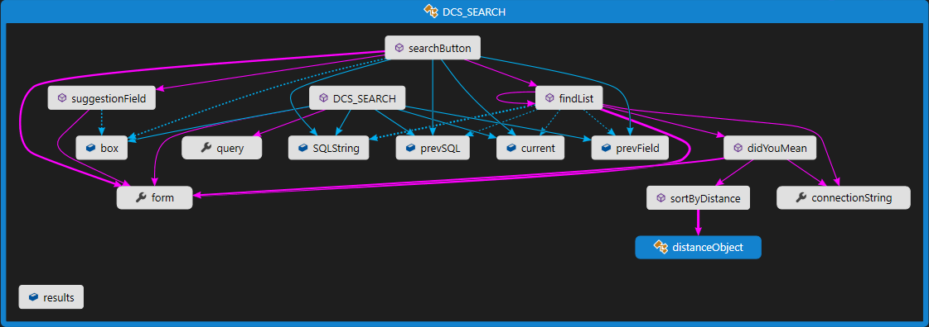
Code Diagrams
Specific Class Example – DCS_SEARCH

Slide 9
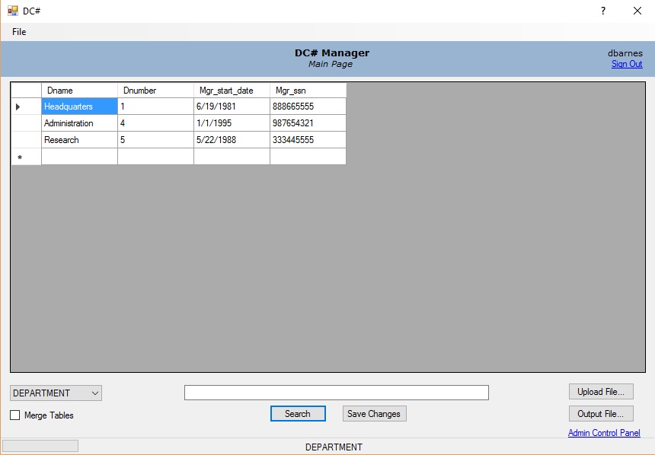
Graphical User Interface
Main Interface – Form1()

Slide 10
Design Tools and Resources
Visual Studio 2015
C# and .NET Framework
Team Foundation Server
Azure Database Services
SQL Server Management Studio
DC# Converter
Damerau Levenshtein Algorithm

Slide 11

Future Plans
Release as an open source project on Github.
Incorporate in a large software suite known as DC#.
Continue development after graduation.
Encourage others to partake in development.

